Slide 1
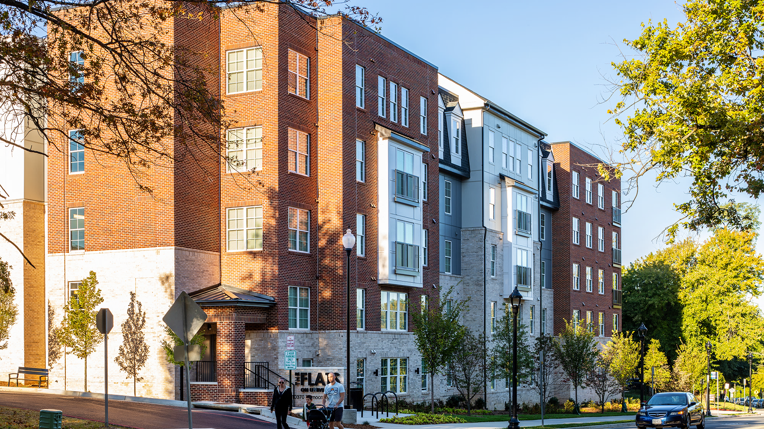
Capstone Communities
University Baptist Church Final Presentation – November 13,2023

Slide 2
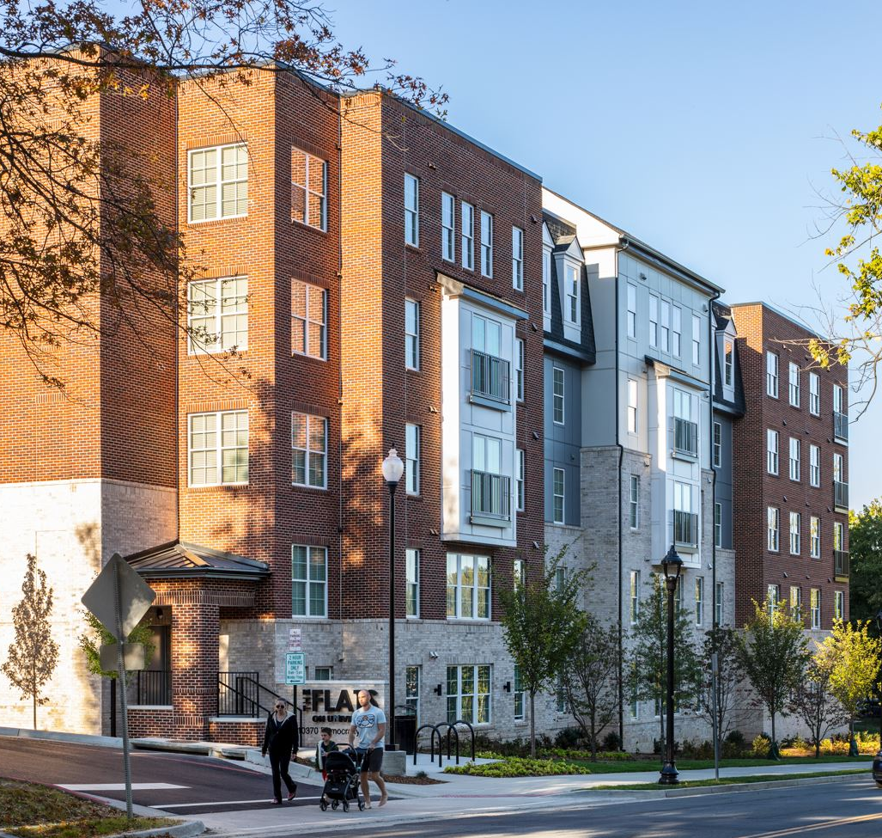
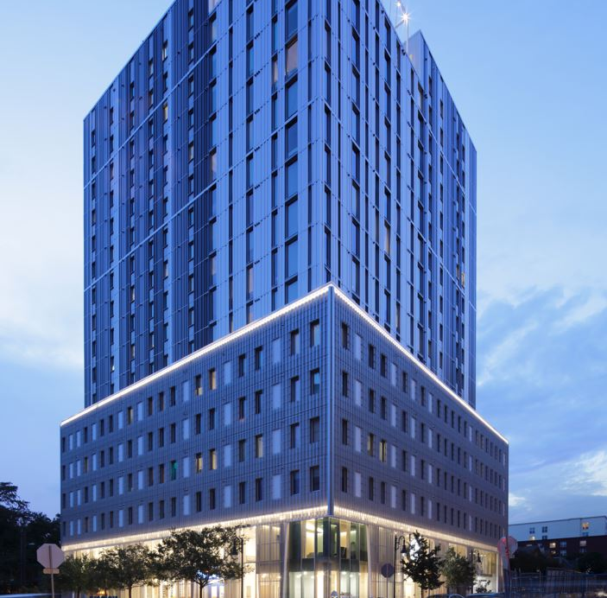
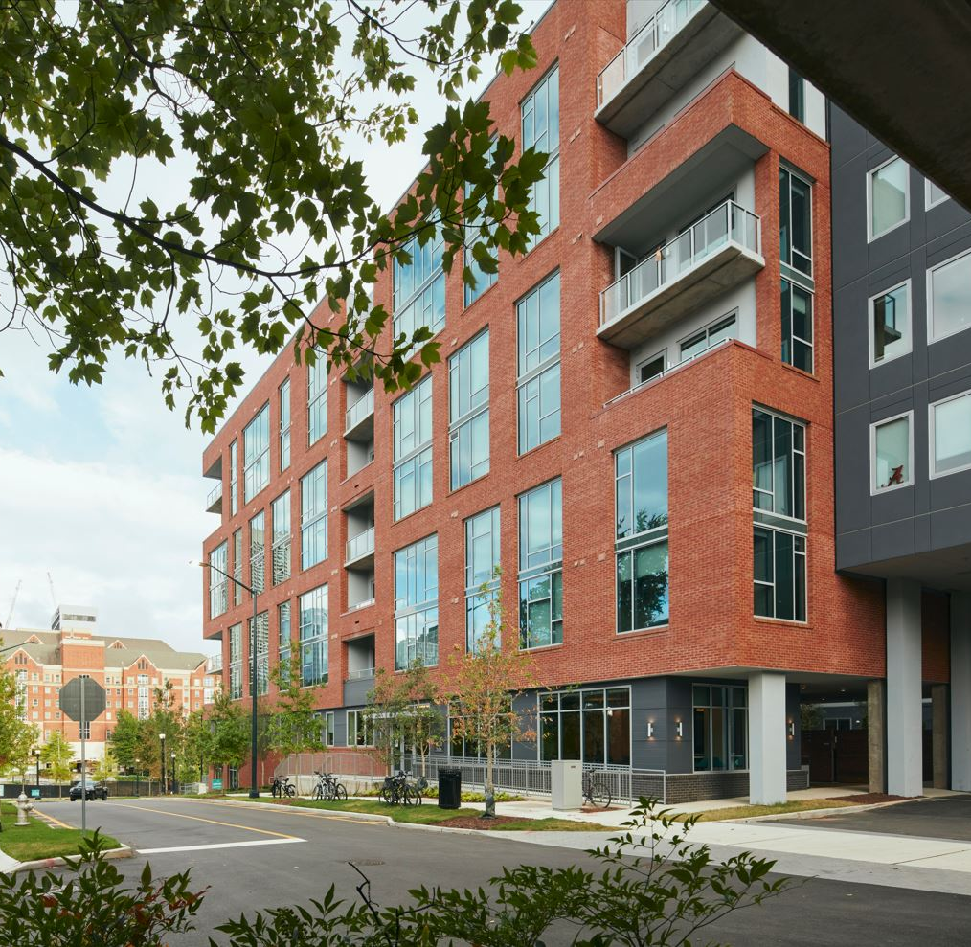
Capstone’s Experience: A History of Successful Execution
The Flats on University
Fairfax, VA
Project Scope: Downtown Fairfax, close to George Mason University, housing 825 residents in a wood-frame building. Community nestled into vibrant, retail driven area.
Inspire on 22nd
Austin, TX
Project Scope: Mixed-use development, walkable to University of Texas. Includes 439 residents, worship space for The Wesley Foundation, office and recreation space.
Inspire Atlanta
Atlanta, GA
Project Scope: Two-building community home to 750 residents at Georgia Tech, where they can live, play, study and relax in an amenity rich development.
Notes:
Project description #1:
Project description #2:
Project description #3:

Slide 3
Capstone Proposal Summary
New Church: 30,000 SF church facility (designed to UBC specifications)
All Cash Purchase
$100K earnest money deposit at effective date of Purchase & Sales Agreement
Additional $150K deposited at beginning of entitlement period
Additional lump sum cash payment ranging between $4.5M and $10.1M, (depending on the project goals established by both UBC and Capstone)
Capstone proposes a transparent, open-book partnership with UBC. Capstone’s goal is to build both a legacy church facility and a sizeable endowment for UBC, while still building a financeable mixed-use project.
By working as a team with these shared goals, Capstone proposes a profit-sharing concept with UBC. For example, by holding the new church facility costs to a pre-established budget, Capstone can pay UBC more in a lump sum cash payment at Closing.
3

Slide 4
Major Project Milestones
February 2024
Purchase & Sales Agreement Executed
Due Diligence Begins (4-5 Months)
$100,000 Earnest Money Deposit
Technical Analyst & Pre-Submittal Meetings
December 2023
UBC Selects Development Partner
February 2026
Entitlement Period Ends
Zoning & Public Hearings
Technical Design
Building & Grading Permits
June 2024
Due Diligence Ends
$100,000 Deposit becomes non-refundable
Entitlement Period Begins
$150,000 Additional Earnest Money Deposit
April 2026
Land Acquisition & Project Financing Closing
Construction of New Church Begins
June 2027
New Church Construction Complete
UMB Moves-In to New Church
June 2028
Residential and Retail Construction Complete
May 2026
Residential and Retail Construction Begins

Slide 5
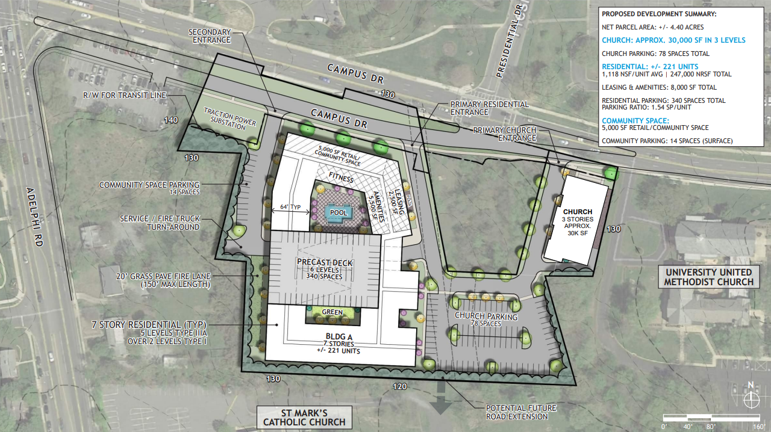
Our Proposal
Freestanding Church 3-Levels 30,000 Square Feet 78-Parking Spaces | Residential 221-Units 340-Parking Spaces Includes Affordable Living
Retail/Community Benefit 5,000 Square Feet | Renewable Energy Rooftop Solar Panels LEED Elements*
*The Community will adopt elements of sustainable rating systems such as the U.S. Green Building Council’s Leadership in Energy and Environmental Design (LEED) program, the Earthcraft program, and other design and construction features to maximize the natural qualities of the site and provide energy savings to the community.
Total Units | Unit Types | Total Bedrooms to be Leased
42 | 1 Bedroom / 1 Bath | 42
60 | 2 Bedroom / 2 Bath | 120
8 | 3 Bedroom / 3 Bath | 24
91 | 4 Bedroom / 4 Bath | 364
20 | 5 Bedroom / 5 Bath | 100
221 | Project Total | 650
*New Church Footprint is subject to C3 independent verification of setbacks
Inclusive of 5% Affordable housing units.

Slide 6
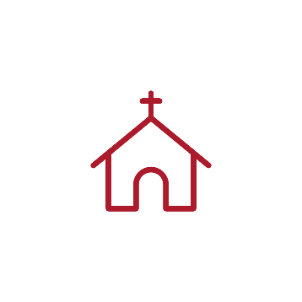
Community Benefits
New State-of-the-Art UBC Facility
New State-of-the-Art UBC Facility to promote local worship and fellowship.
Diverse Housing
The Prince George’s County Purple Line Inclusionary Zoning Study (Final Draft, December 2020) advocates utilizing appropriate public incentives, including PILOT Tax Abatements, to incentivize developers to address the shortage of county housing to households earning 100% AMI and below.
This project is currently targeting 5% workforce housing units at 50% AMI, if sufficient public gap financing are obtained. The affordability AMI percentage can be adjusted depending on stakeholder input.
Maximum Workforce Housing Rates (HOME Rates as of 2023 w/utilities included).
Housing with Wide Demographic Appeal
Project designed to cluster Affinity Groups.
Provides added privacy to the 1 & 2 bedroom units – which are attractive to working professionals, graduate students, visiting UMD faculty, and UMD Staff.
Capstone’s Professional on-site management will include courtesy manager(s) that live on the premises to address issues that negatively impact the quiet enjoyment of the property. These courtesy manager(s) reinforce a culture of quiet enjoyment and respect for all abutting neighbors.
Sustainable Development
On-site Roof Top Solar Panels
Project includes elements of LEED sustainable energy ratings.
Promote positive climate advocacy.
Church Congregation Apprentice Program
Bozzuto Construction will offer training and apprentice programs to youth ministry in the areas of construction management and other trades.
Pedestrian/Transit-Oriented
Continue College Park’s momentum of building high-quality, pedestrian-oriented mixed-use development.
Vibrant, mixed-use communities are a goal of transit-oriented development and the Purple Line Corridor Coalition (PLCC).
Unit | 50% AMI | 80% AMI
Efficiency | $1,687 | $2,109
1 Bedroom | $1,809 | $2,261
2 Bedroom | $2,171 | $2,714
3 Bedroom | $2,508 | $3,134
4 Bedroom | $2,798 | $3,498
5 Bedroom | $3,086 | $3,858

Slide 7
Financial Impact of UBC Programming Requirements
Additional Cash Paid to Church
 | Previous Options |  |  | Final Option One |  | Final Option Two
Overview | 1 Original RFP Submittal Proposal | 2 22,000 SF Church | 3* 22,000 SF Church Includes 40% Tax PILOT | 4 30,000 SF Church NO Tax Pilot | 5 30,000 SF Church NO Tax Pilot | 6* 30,000 SF Church Includes 60% Tax Pilot | 7* 30,000 SF Church Includes 60% Tax Pilot
Date of Scenario | (Original) | 9/22/23 | 9/22/23 | 11/13/23 | 11/13/23 | 11/13/23 | 11/13/23
Total Unit/ Bed Count | 221 | 221 | 221 | 221 | 221 | 221 | 221
Market Rate Unit Count | 181 | 181 | 198 | 210 | 210 | 210 | 210
Affordable Housing Unit Count | 40 (120% AMI) | 40 (120% AMI) | 23 (12 at 50% AMI and 11 at 80% AMI) | 11 (50% AMI) | 11 (50% AMI) | 11 (50% AMI) | 11 (50% AMI)
Church Improvements | 15,000 SF | 22,000 SF | 22,000 SF | 30,000 SF | 30,000 SF | 30,000 SF | 30,000 SF
Church Improvement Costs | $6M | $8.8M | $8.8M | $16.5M | $12M | $16.5M | $12M
Assumed Church Construction Price PSF | $400/ psf | $400/ psf | $400/ psf | $550/ psf | $400/ psf | $550/ psf | $400/ psf
Church Financial Compensation- If Church Elects to Sell Land Fee Simple
Church Improvements | 6,000,000 | 8,800,000 | 8,800,000 | 16,500,000 | 12,000,000 | 16,500,000 | 12,000,000
Additional Lump Sum Payment at Closing | 10,500,000 | 7,300,000 | 13,300,000 | - | 4,500,000 | 5,600,000 | 10,100,000
Total Financial Package to Church | 16,500,000 | 16,100,000 | 22,100,000 | 16,500,000 | 16,500,000 | 22,100,000 | 22,100,000
* Requires discretionary county approval
7

Slide 8
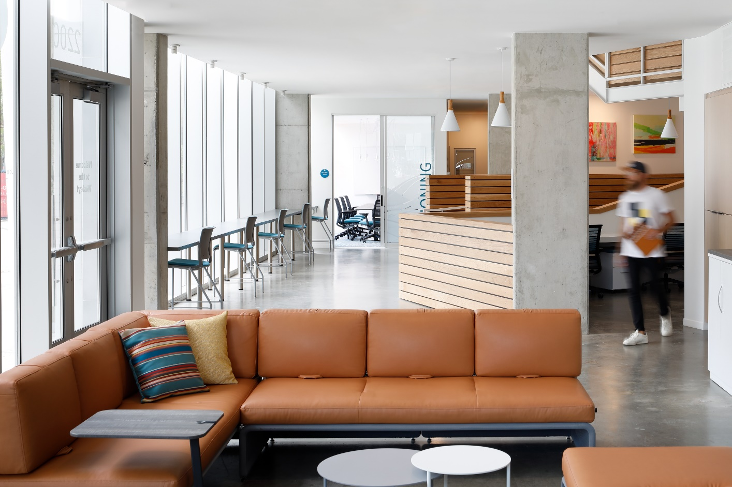
Collaboration with University Baptist Church: Elevating The Site Together
Capstone partnered with the Wesley foundation to build a new campus ministry facilities within Capstone’s development in Austin, TX.
“…you offered a creative solution of the underlying financial structure, listened to all of our needs and ensured a successful implementation. Simply put, I think your stewardship of this mixed-use project from inception through lease-up was admirable. As a faith-based organization, I appreciated the way the Capstone team was open to and aware of the values and essentials of that aspect of our organization and project. They were willing to listen, plan and make adjustments with us as we would articulate these values.”
Rusty Teeter
Executive Director – Wesley Foundation
Capstone is equally committed to this same standard in delivering new church facilities for UBC which will enhance the church and its congregation’s mission in many years to come.

Slide 9
For more detailed information, see
Final Presentation Addendum below

Slide 10
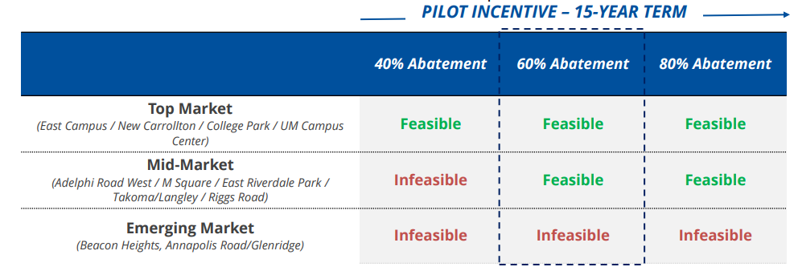
Prince George’s County Purple Line Inclusionary Zoning Study
*Taken from Dec 2020 County Report*
When incorporating an affordability requirement and corresponding PILOT incentive, development still cannot be supported uniformly across the entire Purple Line Corridor.
With a 60% PILOT, which is similar to existing County deals with developers, an IZ requirement to
provide 5% of units at 50% AMI cannot be supported across the entire Purple Line Corridor.
However, development is feasible in some top of market locations, signaling that the County could
put in place affordability requirements on a project-by-project basis where feasible when
providing PILOT.
DEVELOPMENT FEASIBILITY TESTING – 5% OF UNITS AFFORDABLE AT 50% AMI
New Midrise Rental Development

Slide 11
Church Compensation Notes
Capstone is currently proposing 5% affordable housing units at 50% AMI (The affordable unit count and AMI % are subject to stakeholder’s discretion) . In order to provide this affordable component development incentives/ gap financing such as Affordable or Economic Development Tax PILOTS, Transit-Oriented Development (TOD) Targeted Incentives, Economic Development Incentive (EDI) grants, College Park Revitalization Tax Credits or other project development incentives must be Approved by Prince George’s County.
New Scenarios 1 and 2 were not included in Capstone's original RFP Proposal but were added in Capstone’s Post-Interview Executive Summary submittal on September 25th.
We are now assuming the church improvements have grown to 30,000 SF from the previously discussed 15,000 SF and the 22,000 SF.
New Scenario 2 & New Scenario 3 – Tax Abatement (TA) assume public development incentives/ gap financing are included, which are subject to approval by government approval, primarily by Prince George’s County. As such, the financial assumptions above are included at this time only for discussion purposes to illustrate how Capstone's total financial compensation paid to the church can potentially be increased beyond Capstone's original RFP Proposal if Capstone and the church collaborate to lobby county leaders to approve development incentives for the project. These Development Incentives may possibly allow Capstone to increase the total compensation package paid to the church, but does NOT commit Capstone to these exact figures at these early stages because of the numerous unknown variables in the financial metrics at this time, including construction costs at time of construction, supply/ demand factors affecting rental rates, and the number of units that are ultimately approved by Prince George’s County, among other factors.
New Scenario 2 has increased the retail space rental rate from $25/psf to $30/psf to reflect market rents vs. non profit incubator space; $500,000 in park improvements was removed from budget to reflect the elimination of public park since church prefers new church in same location.
New Scenario 2 assumes a 40% Economic Development or Affordable Housing 15-year Tax PILOT and a $1.2M Public Safety Surcharge Waiver is Approved, but conservatively does NOT include any other potential incentives such as County Economic Development Incentive Funds (EDI), HOME Funds, Housing Investment Trust Fund, City of College Park Revitalization Tax Credits or any other incentive is Approved.
Capstone can provide a table with the total church compensation package assuming church elects to ground lease land to Capstone, upon request, given that UBC has expressed that a fee simple option is preferred.
Purchase and Sale Agreement to acquire church property will include a $100K Initial Earnest Money Deposit at PSA Contract, plus $150K in Additional Earnest Money Deposit due at the expiration of Due Diligence and Beginning of Entitlements.
Changes in capital market conditions between today and project commencement/financing may require to Capstone to solve for a higher Return on Cost.

Slide 12
Church Compensation Notes
Summary of the Analysis/Evolution of Previously Proposed Business Terms:
Earnest Money Deposits (EMD) were 60% lower than current Proposal.
New church improvements were previously studied at both 15,000 sf and 22,000 sf assuming a construction cost of $400/ psf.
Seeking to include an affordable housing component as a project community benefit, C3 initially assumed 18% (40 units) of the housing units could be made available at 120% AMI. Under this scenario, if UBC receives a 15,000 sf new church, C3 previously offered a $16.5M payment to the church. Of that it was assumed $6M would pay for the church improvements ($400/psf construction costs) and the remaining $10.5M would be paid in a lump sum to the church. If the new church grows to 22,000 sf, with these 18% of units at 120% AMI, the total payment to the church would be $16.1M, but the lump sum payment would be reduced to $7.3M.
At the same time the church asked for the larger 22,000 sf new church, Capstone also decided to analyze a new affordability scenario whereby a lower 10% of the units are provided at a lower affordability requirement of 50% and 80% AMI. Under this scenario, if Capstone is able to secure a 15-year 40% PILOT Tax Abatement, the lump sum paid to the church increases significantly to $13.3M plus $8.8M for the new church facility (@ $400/psf), or $22.1M in total church compensation.

Slide 13
Church Compensation Notes (Cont’d.)
Summary of Proposed Best and Final Business Terms:
60% higher Earnest Money Deposits (EMD)
C3’s BAFO assumes the church land is acquired fee simple. C3 is also amenable to a Ground-Lease structure should UBC choose to explore this option. Detailed financial metrics can be provide, upon UBC request.
Capstone funds and constructs 30,000 sf new church to specifications acceptable to UBC congregation
5% of residential units at 50% AMI Affordability Requirements
$16.5M in C3 funded new church facility and NO additional lump sum payment made to UBC (assuming 30,000 sf @ $550/psf UBC approved church facility and that NO PILOT Tax Abatement is approved by County). Total church financial package of $16.5M.
$12M in C3 funded new church facility and an additional $4.5M additional lump sum payment made to UBC (assuming 30,000 sf @ $400/psf UBC new church facility and that NO PILOT Tax Abatement is approved by County). Total church financial package of $16.5M.
$16.5M in C3 funded new church facility and an additional $5.6M lump sum payment made to UBC (assuming 30,000 sf @ $550/psf UBC approved church facility and that a 15-year 60% PILOT Tax Abatement is approved by County). Total church financial package of $22.1M.
$12M in C3 funded new church facility and an additional $10.1M lump sum payment made to UBC (assuming 30,000 sf @ $400/ psf UBC new church facility and that a 15-year 60% PILOT Tax Abatement is approved by County). Total church financial package of $22.1M.
C3 is committed to negotiating a total compensation package to UBC greater than if proposed terms if Capstone can exceed its targeted financial benchmarks.
C3 provides these options for a range of total financial remuneration (new church improvements plus a lump sum payment to provide a financial endowment for UBC’s future) to UBC primarily to help guide the church’s internal discussions relative to prioritizing it’s considerations such as church size/ specifications, community benefits and other church requirements. We hope this analysis is beneficial; however, C3 remains open and flexible to analyzing the financial metrics of this project under any and all assumptions required by UBC moving forward.

Slide 14
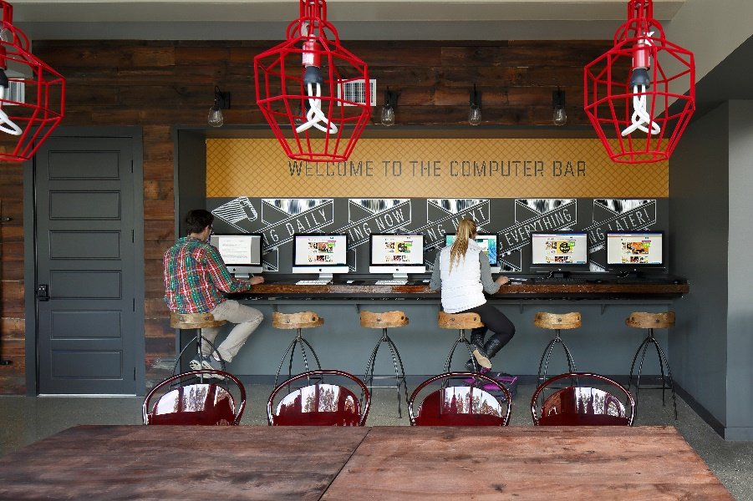
Financing Structure History of Experience through Partnerships
Capstone has over thirty years of development experience, and since 2020 alone, has capitalized more than $800 million in total development costs and nearly 3,400 units across a mix of student, senior, and multifamily communities all over the country.
During that time, Capstone used a number of Senior Debt lenders, including First Horizon, Truist, Fifth Third, Synovus, Cadence Bank, Trustmark, and many others. These senior lenders provided debt between 60% to 70% LTC.
For the remaining equity portion of the capital stack, Capstone has used multiple structures, including traditional JV (waterfall) equity, mezzanine debt, and preferred equity, partnering with large publicly traded REITs, institutional equity, and boutique investment firms. Previous partners include Kayne Anderson, Harrison Street, BlueRock, Capital Solutions, Seminole Financial Services, UC Funds, and Marble Capital.
Capstone will privately fund this project with debt and equity from our long-standing relationships with previous capital partners.

